Slide 1


Social Media Analytics
Fabrizio Cominetti, 882737
Ruben Agazzi, 844736

Slide 2

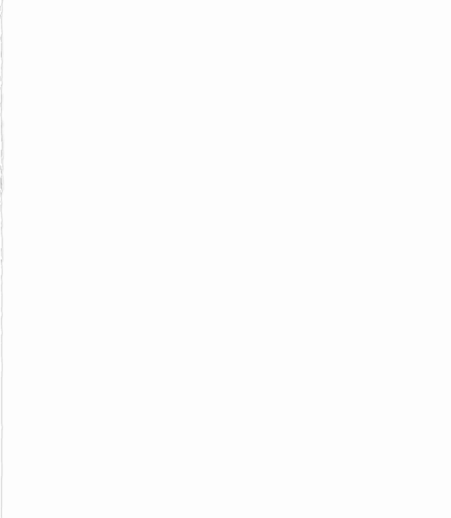
Analysis of Italian Tweets Smart Working
The topic related to smart working has taken a prominent place in work-related discussions, especially following the latest changes on the issue from the government. So, we decided to analyze tweets about smart working in Italy.

Slide 3
Data Collection
Using the API provided by Twitter and the Python Tweepy library, we performed a download of Tweets containing one or more of the following keywords:
• smartworking;
• remotework;
• lavoroagile;
• smart working;
• remote work;
• lavoro agile.

Slide 4
Data Pre-Processing
No Duplicates
Change Date format
Remove Numbers
Lower Text
Lemmatization
Remove Punctuation
StopWords Deletion
Tokenization
Notes:
2

Slide 5
Social Network Analysis
Notes:
1

Slide 6
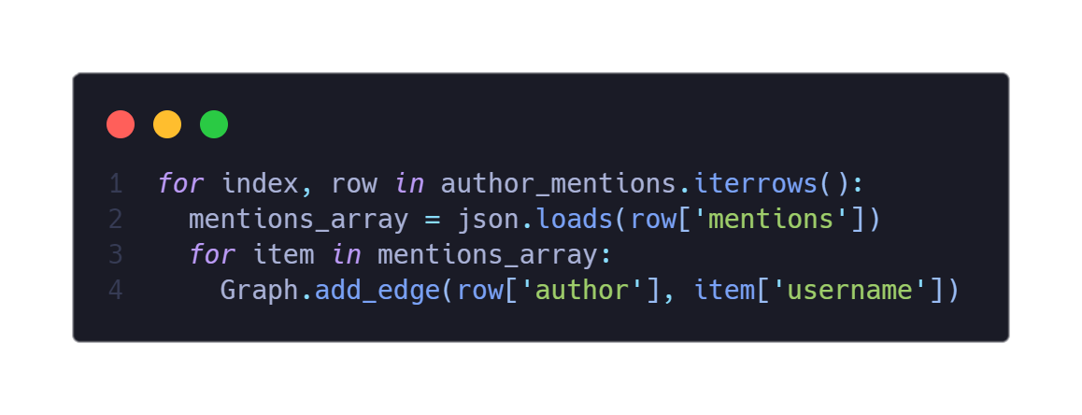
Graph Creation
In order to create the graph of the interactions, we took for each tweet created by a user its mentioned users, these last will be nodes of the graph.
For every user mentioned inside a tweet we created an edge between the two nodes.
For graph creation and graph analysis we used the python library NetworkX.

Slide 7
Social Network Analysis
Nodes Degree
Average Degree
Assortativity
Community Detection
Notes:
3

Slide 8
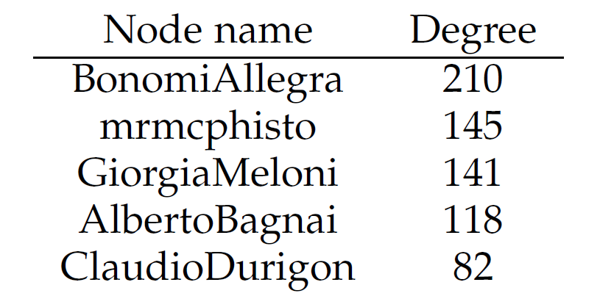
Nodes Degree and Average Degree
For each node, we calculated its degree (the number of incident edges that the node have). After that, we calculated the average degree between all nodes, which is equal to 3.704.
Notes:
6

Slide 9
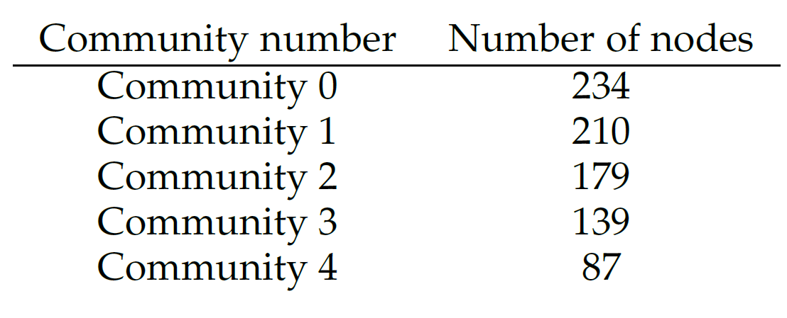
Community Detection
For the community detection part, we used the library NetwokX with modularity maximization in order to find the communities. The algorithm found 197 different communities, where the bigger community contains 234 different nodes.
Notes:
8

Slide 10
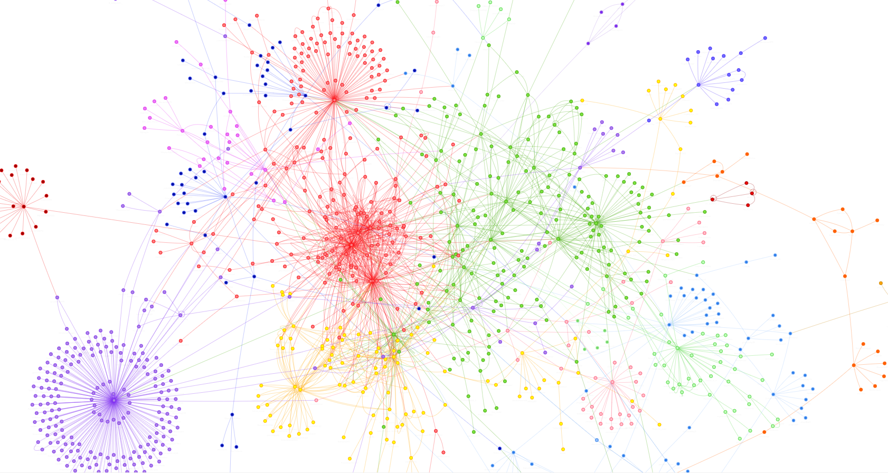
Assortativity
We also calculated the assortativity of the interaction network. We found an assortativity coefficient equal to -0.244, which makes our network disassortative.
In this case, smaller nodes tends to connect to bigger nodes in terms of degree.
Notes:
9

Slide 11
Social Content Analysis
Notes:
5

Slide 12
Social Content Analysis
Sentiment Analysis
Emotion Recognition
Notes:
7

Slide 13
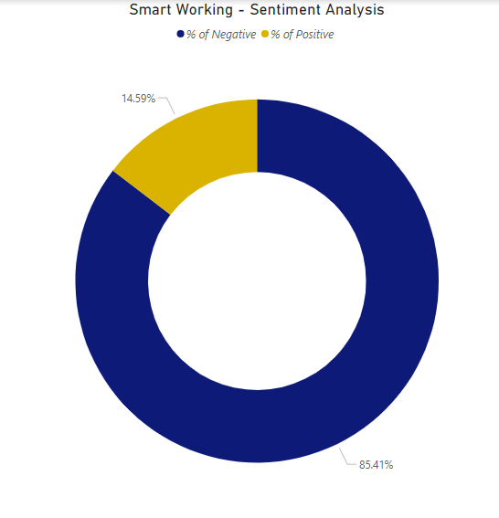
Sentiment Analysis
With the use of FEEL-IT, based on (Um)BERT(o), we calculated the sentiment score of the tweets in the dataset. As we can observe, the great majority of tweets was labeled as ‘negative’.
Notes:
8

Slide 14
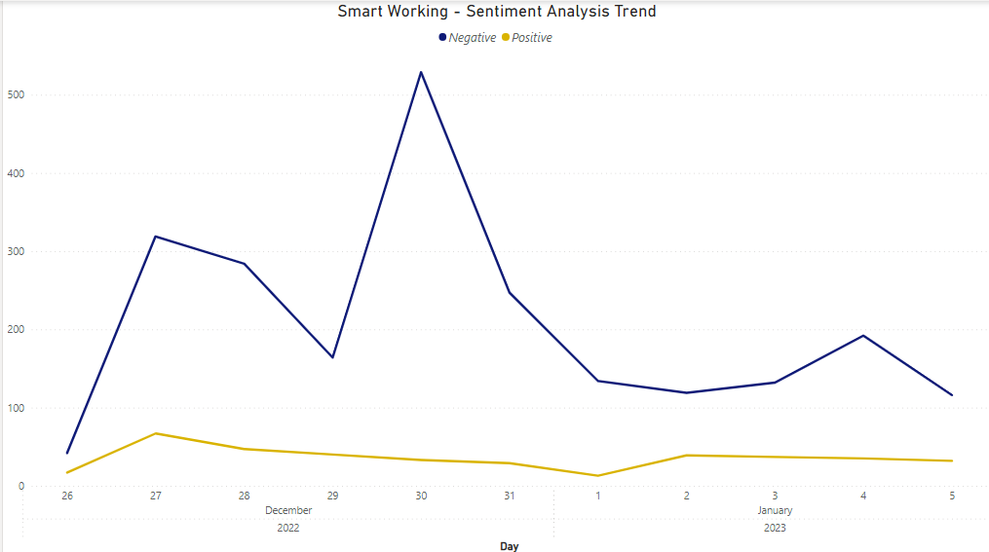
Sentiment Analysis
On the left, we can observe the time series related to the sentiment of the tweets considered.
30/12 was the day when a large majority of tweets were made, and also the day with a high level of negative sentiment.
Notes:
13

Slide 15
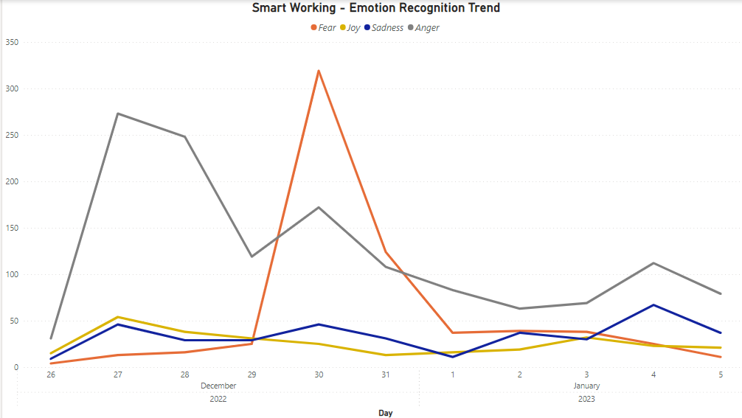
Emotion Recognition
Through FEEL-IT, we identified the emotions present in the various tweets: anger, fear, joy, and sadness.
As observable, the emotion anger is the most prevalent, while the emotion fear has a peak on the day of 30/12.
Notes:
14

Slide 16

Findings
With this social network analysis, we obtained some interesting information from both the social network analysis and from the sentiment analysis tasks:
We found out that even with a relatively small number of tweets, users create large interaction networks and communities
We found out that the relevant emotion about the topic of smart working, in the recent past, is mostly “anger”, probably due to the limitations that were announced.
Notes:
12

